Slide 1
HE1002 Macroeconomics I Problem Set 10
-Andy Neo Gao Jun
-Gao Wenbo
-Vanneshia Swiegl Lee
-Yu Jiaqi
-Zhu Yuelin

Slide 2
Question 1 An economy has two workers, Bella and Edward. Per day of work, Bella can pick 100 apples or 25 bananas, and Edward can pick 50 apples or 50 bananas. Bella and Edward each work 200 days per year. (a) Which worker has an absolute advantage in apples? Which has a comparative advantage? Calculate each worker's opportunity cost of picking an additional apple.

Slide 3
A person has an absolute advantage at a particular task if he or she can perform the task in fewer hours than the other person
Production Units | Apples | Bananas
Bella | 100 | 25
Edward | 50 | 50
As Bella can pick 100 apples/day > 50 apples/day, Bella has an absolute advantage in picking apples.
A person has a comparative advantage at a particular task if his or her opportunity cost of performing the task is lower than the other person’s opportunity cost.
Opportunity cost = sacrifice of one good / gain of the other good
Opportunity Cost | Apples | Bananas
Bella | 25/100=0.25 | 100/25=4
Edward | 50/50=1 | 50/50=1
Bella has a lower opportunity cost in picking an additional apple, (0.25<1), she has a comparative advantage in picking apples.
Edward has a lower opportunity cost in picking an additional banana, (1<4), he has a comparative advantage in picking bananas.

Slide 4
(b)
Find the maximum number of each type of fruit that can be picked annually in this economy, assuming that none of the other type of fruit is picked. What is the most of each type that can be picked if each worker fully specializes according to his or her comparative advantage?
Maximising the unit of each fruit picked per year
(no. A Bella can pick/day + no. A Edward can pick/day) x no. of days worked per year
Apples: (100+50) x 200 = 30,000 apples annually
Bananas: (25+50) x 200 = 15,000 bananas annually
2. Maximum production according to comparative advantage
Bella specialises in picking apples:
100 apples x 200 days = 20,000 apples annually
Edward specialises in picking bananas:
50 bananas x 200 days = 10,000 bananas annually

Slide 5
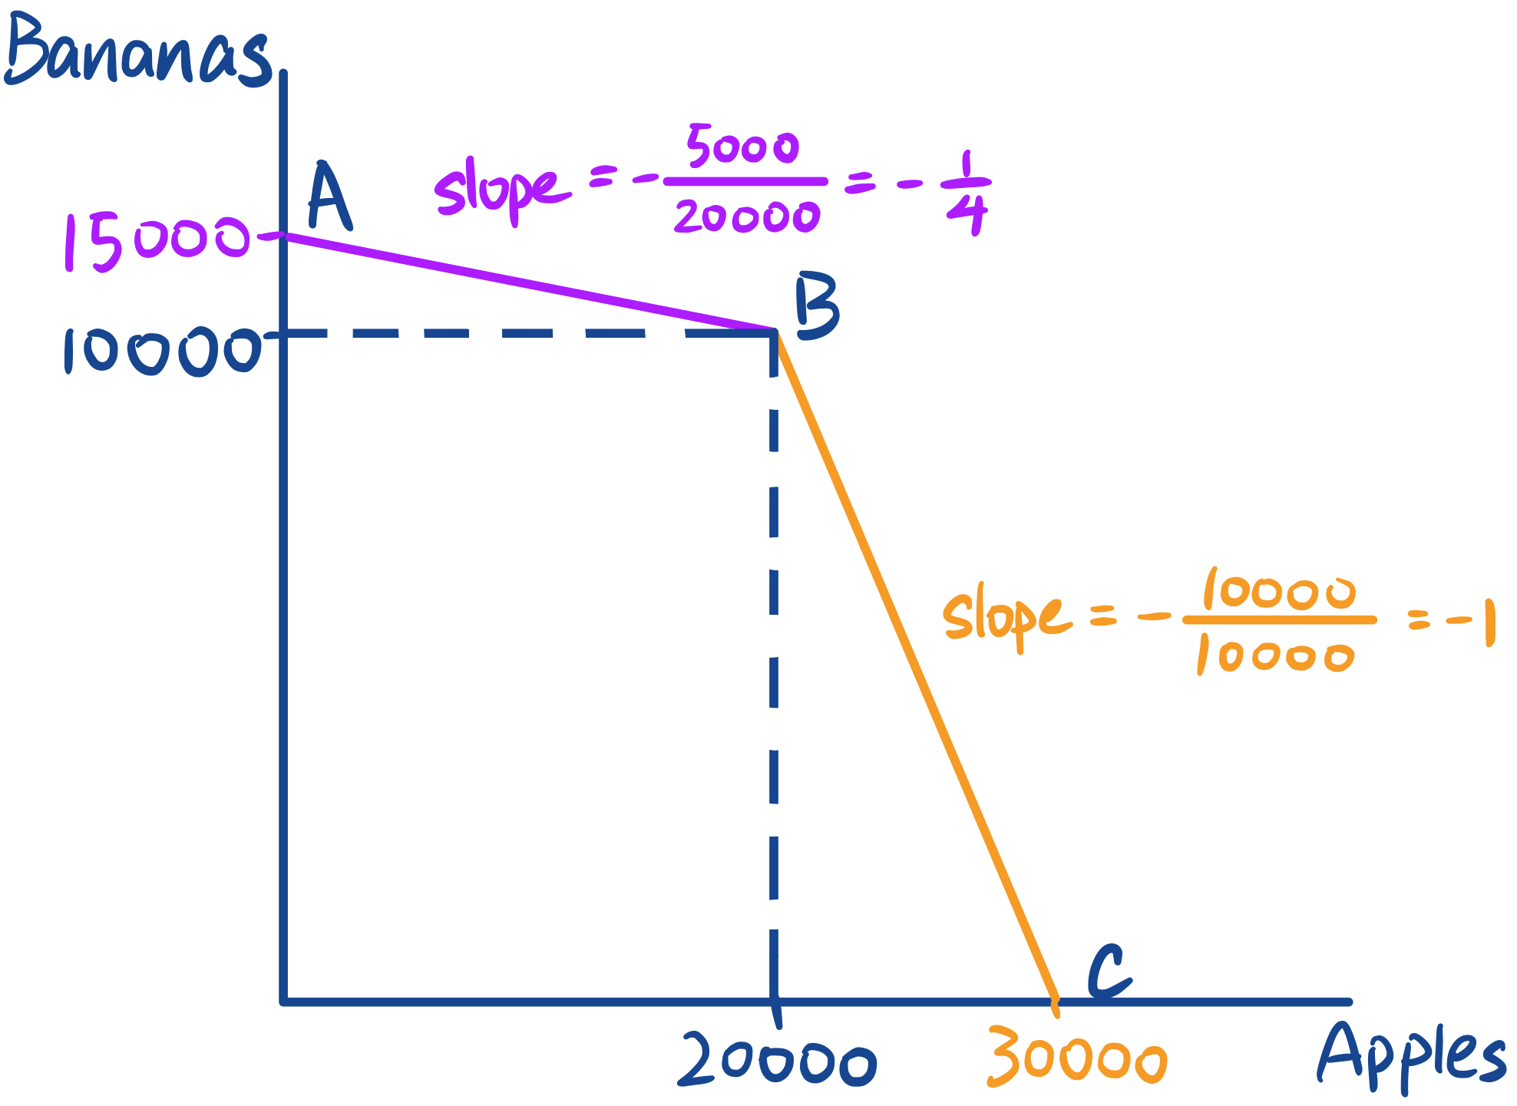
C) Draw the PPC for annual production in this economy. Show numerical values for the vertical intercept, the horizontal intercept, and the slopes of each segment of the PPC.
The intercepts show the maximum amounts of each type of fruit that can be picked.
Purple section: slope of AB = -¼, is Bella's opportunity cost of picking an additional apple in terms of bananas.
Yellow section: slope of BC = -1, is
Edward’s opportunity cost of picking an additional apple in terms of bananas.
At B, Bella specialises in picking apples and Edward specialises in picking bananas.

Slide 6
Question 2 Suppose that Costa Rican worker Carlos can produce either 100 pounds of coffee or 1computer per week, and a second worker, Maria, can produce either 150 pounds of coffee or 1 computer per week. Both Carlos and Maria work 50 weeks per year. (a) Find the PPC for Costa Rica. Give numerical values for the graph’s intercepts and slopes. How much of each good is produced if each worker fully specializes according to comparative advantage?

Slide 7
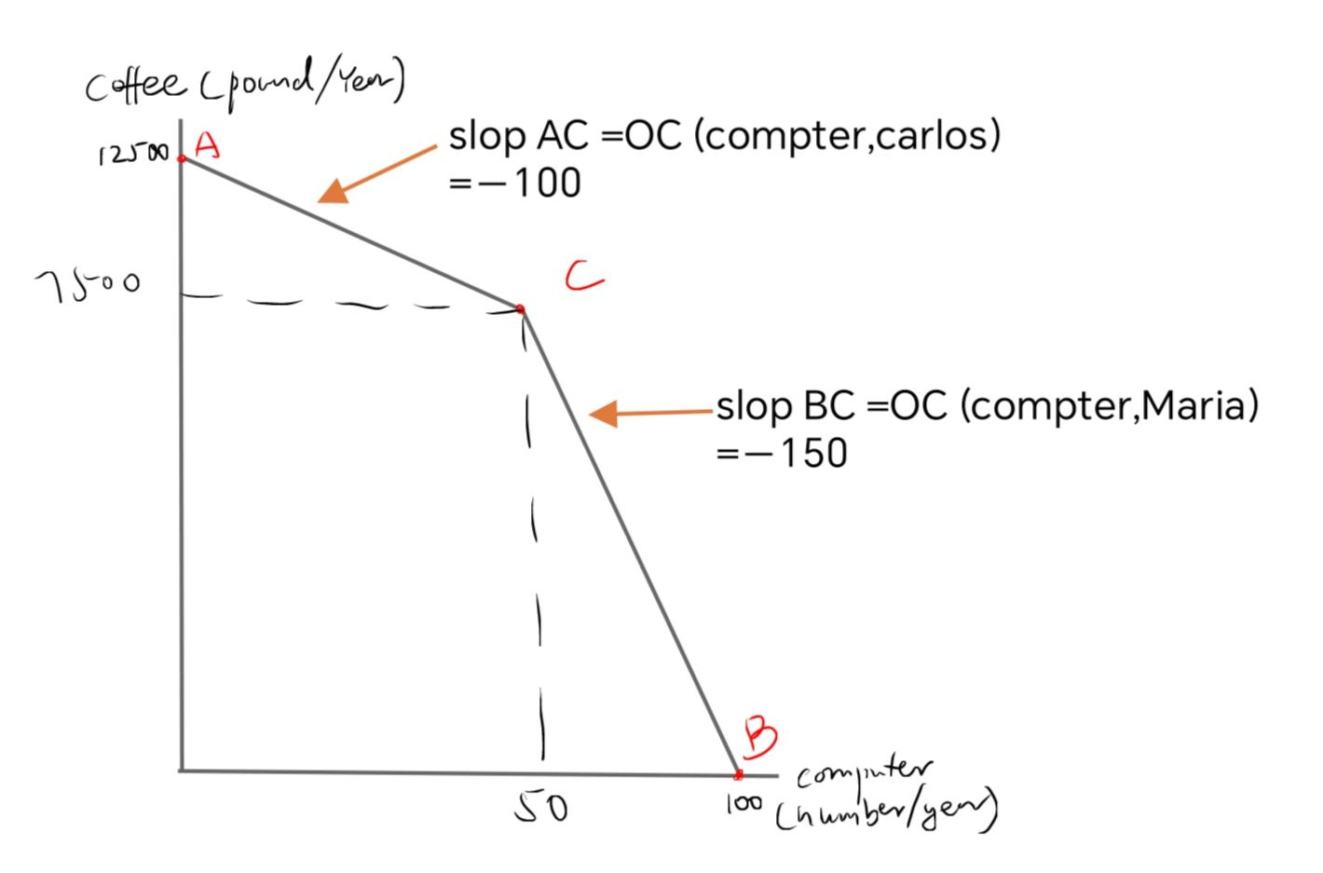
Maximum coffee: (150+100)*50=12500
Maximum computer:(1+1)*50=100
(If each worker specialised on their comparative advantage)
Notes:
To construct the PPC for this two-person economy, we ask first how much coffee Costa Rica could produce if both Carlos and Maria worked full time producing coffee. Between them they can produce 250 pounds of coffee per week, so in 50 weeks they could produce 12,500 pounds of coffee. Thus if we plot coffee production on the vertical axis of the graph of Costa Rica’s PPC, the vertical intercept of the PPC will be 12,500 pounds of coffee per year . Likewise, if Carlos and Maria produced only computers, between them they could produce 2 computers per week, or 100 computers per year. So the horizontal intercept of Costa Rica’s PPC is 100 computers per year.
In the portion of the PPC between points A and C, since Carlos has competative advantage in producing computers so only Carlos is specialised in producing computers, so the slope of the PPC in that range reflects Carlos’s opportunity cost of computers in terms of coffee production forgone which is -100. At point C, Carlos spends all his time on computers and Maria spends all her time on coffee so they produce 50 computers and 7,500 pounds of coffee at point C. Between points C and B, any additional computers must be produced by Maria. Thus between points C and B the slope of the PPC reflects Maria’s opportunity cost of producing computers, in terms of coffee production forgone which is -150

Slide 8
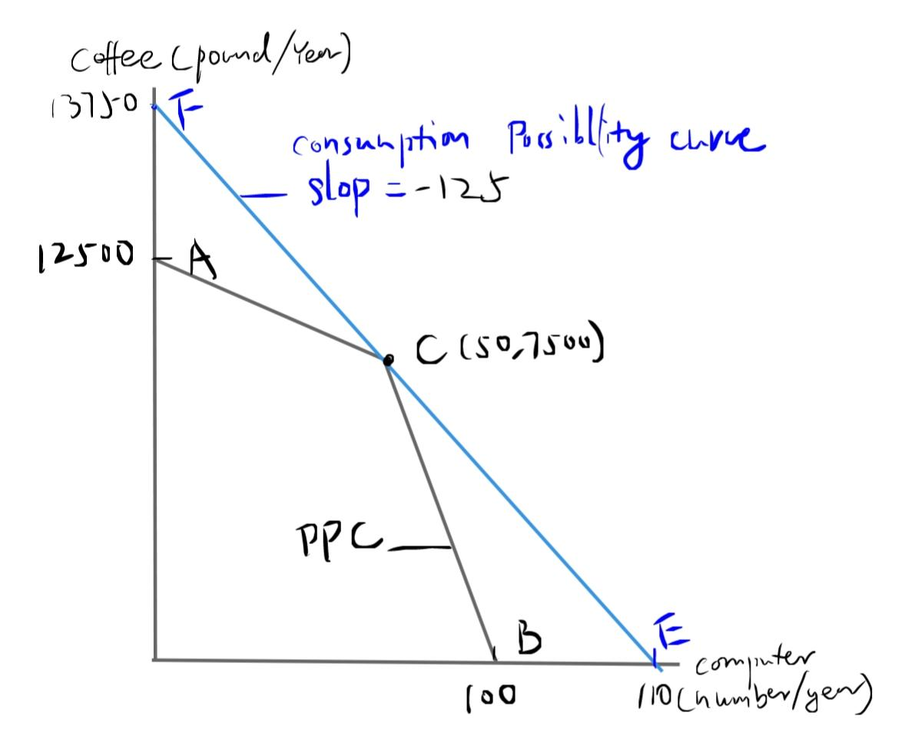
(b)
World prices are such that 1 computer trades for 125 pounds of coffee on
international markets. If Costa Rica is open to trade, show Costa Rica's consumption
possibilities graphically. What is the most of each good that Costa Ricans can consume
when the economy is open?
Increase in computer consumption:7500/125=60
Max. Computer consumption=50+60=110
Increase in coffee consumption:50*125=6250
Max. coffee consumption=12500+6250=13750
Notes:
they can get an extra 125 pounds of coffee for each computer they give up., however, Carlos can trade the 50 computers produced at point C for 6250 pounds of coffee (50*125). Together with the 7,500 pounds of coffee maria produces, the coffee obtained through trade raises Costa Rica’s maximum annual coffee consumptionincrease to 13,750 pounds per year, as indicated by point F .
Similarly, maria can trade 7500 coffee produced at C for 60 computers (7500/125). Together with 50 computer produced by carlos, the consumption of costa rica ‘s maximum computer comsumption raise to 110 per year. As indicated by E.

Slide 9
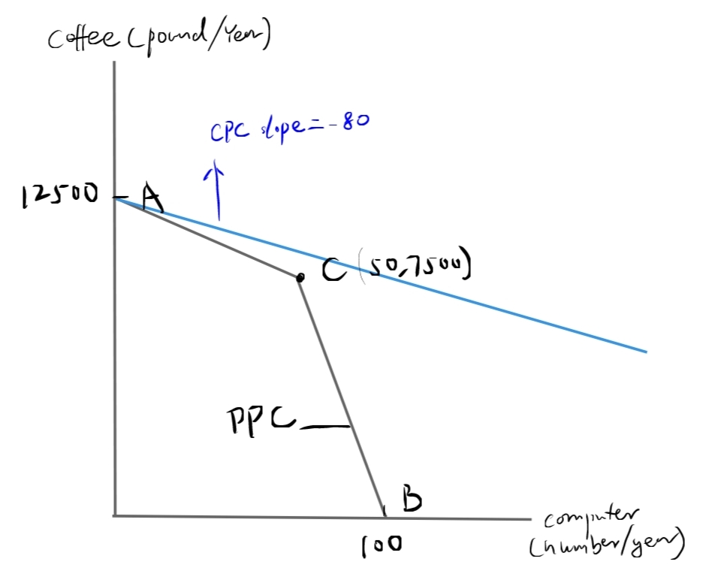
(c) Repeat part (b) under the assumption that 1 computer trades for 80 pounds of coffee on world markets.
Since the opportunity cost of consuming 1 computer (80) is less than both worker’s opportunity cost of producing 1 computer( 100 and 150),
They should produce at the maximum amount of coffee and use coffee to trade for computer.
Therefore,
max coffee consumption=12500 pounds
Max computer consumption=12500/80=156.25 computers

Slide 10
Question 3
Suppose that Costa Rican worker Carlos can produce either 100 pounds of coffee or 1 computer per week, and a second worker, Maria, can produce either 150 pounds of coffee or 1 computer per week. A third worker, Pedro, joins the Costa Rican economy. Pedro can produce either 140 pounds of coffee or 1 computer per week. All three workers work 50 weeks per year.
(a)
Find the PPC for Costa Rica. Give numerical values of the PPC's intercepts and slopes

Slide 11
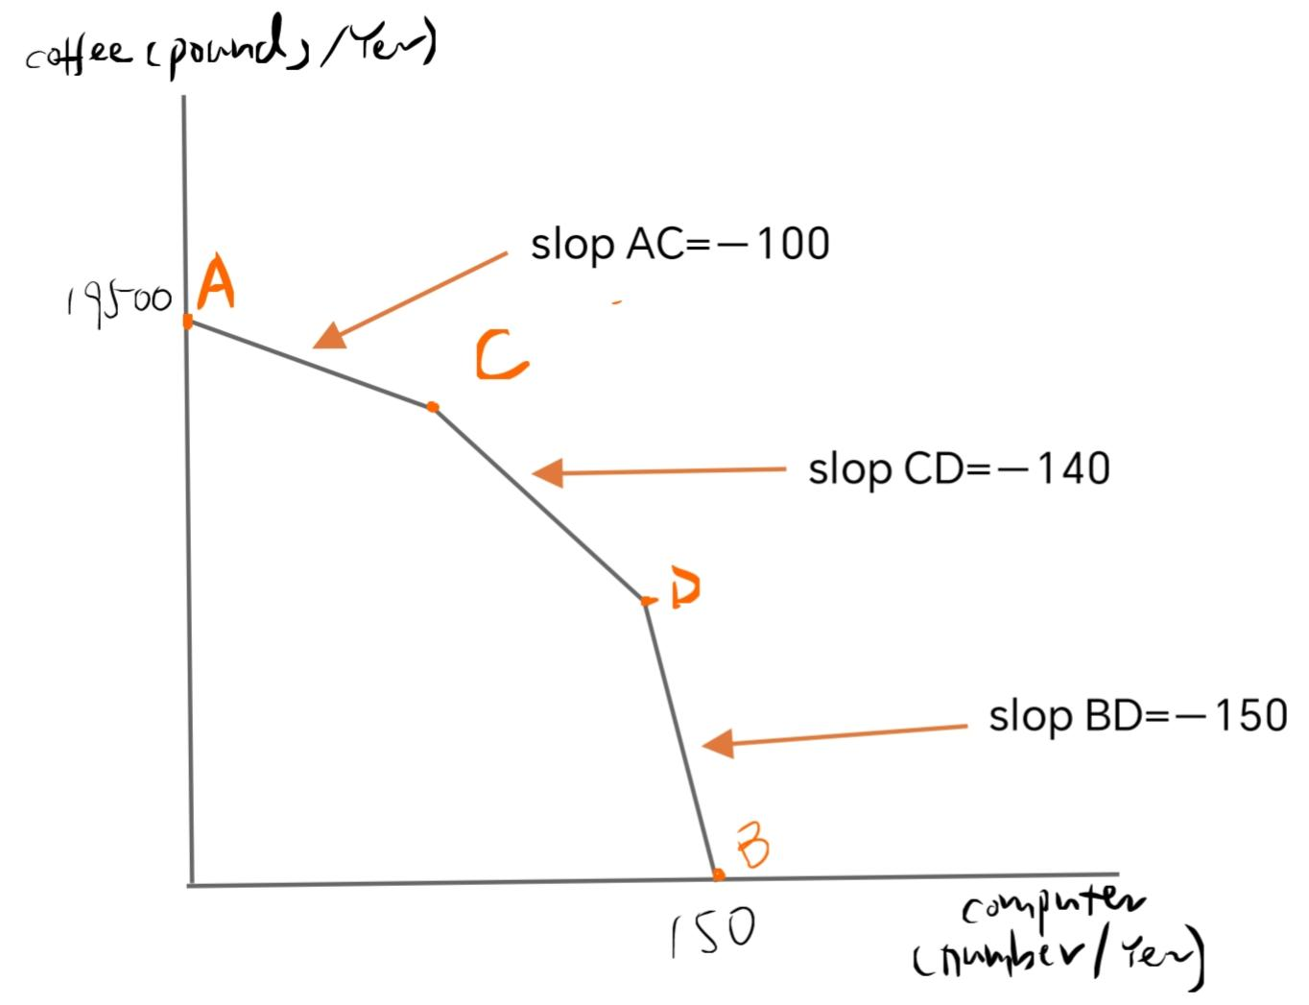
At A: (150+100+140)*50=19500
At B: (1+1+1)*50=150
Notes:
NOTICE that Pedro’s opp cost of producing 1 computer is more than that of carlos but more than that of marias
At point C carlos is dedicating all his time to computer production, so someone else must produce any additional computers. Pedro has the next lowest opportunity cost of producing computers, so (following the Principle of Increasing Opportunity Cost) he begins to produce computers at point C. The slope of the PPC between points C and D is determined by Pedro’s opportunity cost, which is greater than carlos opportunity cost. At point D , Pedro is producing all the computers he can, so finally maria begins to produce computers as well. Thus the slope of the PPC between points D and B reflects maria’s opportunity cost. Because opportunity cost increases as we move from left to right in the figure, the slope of the PPC becomes more and more negative, leading once again to the outwardly bowed shape.
The vertical intersect is when 3 people are all producing coffee
The horizontal intercept is when 3 people all producing computer

Slide 12
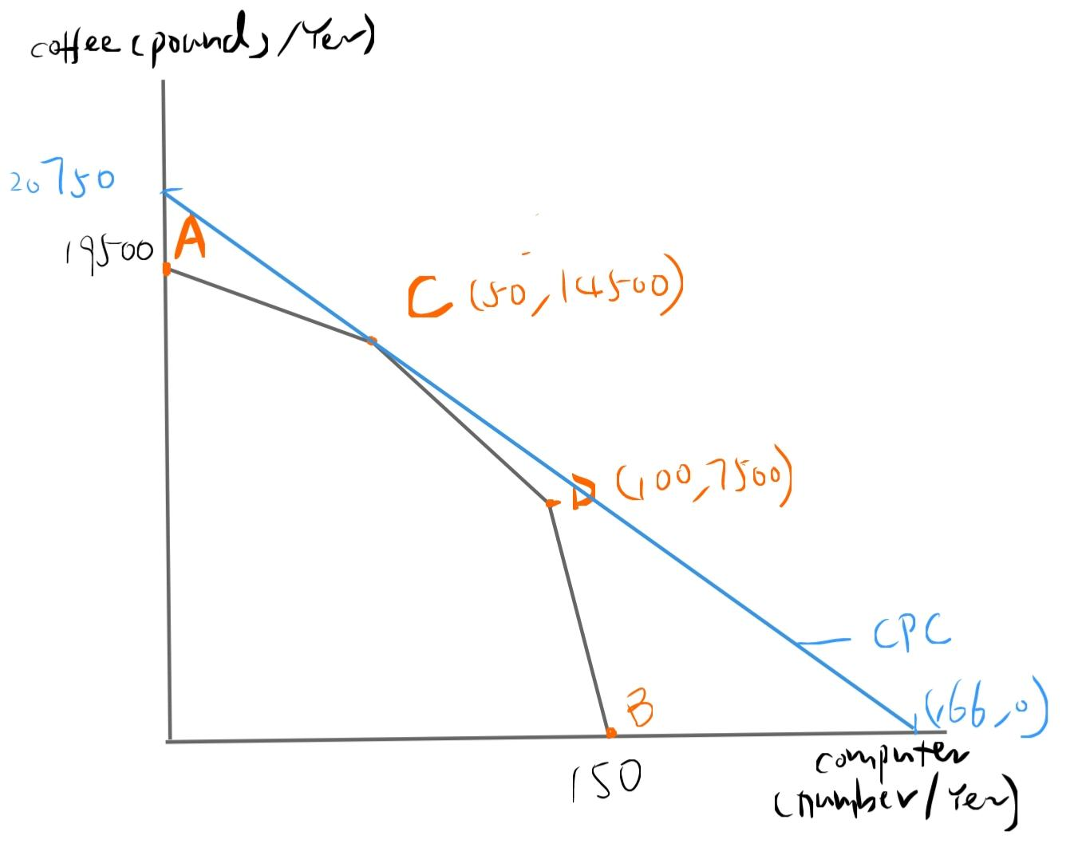
(b)Find Costa Rica‘s consumption possibilities if the country is open and 1 computer trades for 125 pounds of coffee on world markets. What is the most of each good that Costa Ricans can consume when the economy is open? Compare to the situation when the economy is closed.
specialise at point c:
Max coffee consumption : 50*125+14500=20750
Max computer consumption: 14500/125 + 50=166
we have consumption curve; y=-125x+20750
The consumption curve for closed economy is just the PPC.
However, when is economy is open, consumption of both goods can be increased.

Slide 13
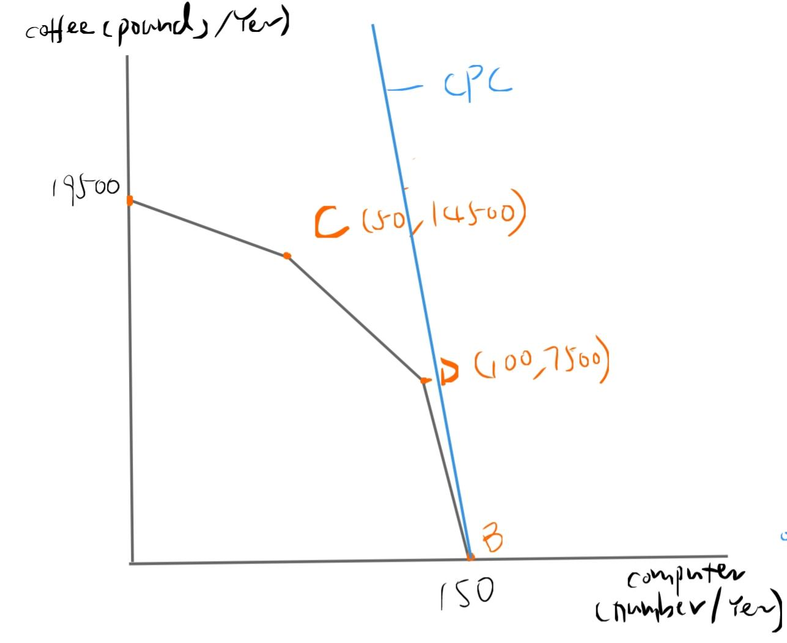
(c) Repeat part (b) assuming that 1 computer trades for 200 pounds of coffee on world markets.
Since the gradiant of the consumption possibility curve is -200 which has greater slop(more negative) than all the worker’s PPC’s grandiant, therefore，the consumption possibility curve could only touch the PPC at point B.
Vertical intercept (max coffee): 150*200=30000
Horizontal intercept(max computer): 150
Equation of CPC: y=-200x+30000
Compare to when the economy is closed, the open economy increase the consumption of coffee by a large amount while the consumption of computer does not change.

Slide 14
Question 4
Suppose that a U.S. worker can produce 1,000 pairs of shoes or 10 industrial robots per year. For simplicity, assume there are no costs other than labor costs and firms earn zero profits. Initially, the U.S. economy is closed. The domestic price of shoes is $30 a pair, so that a U.S. worker can earn $30,000 annually by working in the shoe industry. The domestic price of a robot is $3,000, so that a U.S. worker can also earn $30,000 annually working in the robot industry.
Now suppose that the U.S. opens trade with the rest of the world. Foreign workers can produce 500 pairs of shoes or 1 robot per year. The world price of shoes after the U.S. opens its markets is $10 a pair, and the world price of robots is $5,000.

Slide 15
What do foreign workers earn annually, in dollars?
Foreign workers can produce 500 pairs of shoes or 1 robot per year. The world price of shoes is $10/pair, so a foreign worker can earn 500 pairs/yr x $10/pair = $5,000 annually by working in the shoe industry. The world price of a robot is $5,000, so a foreign worker can also earn 1 robot/yr x $5,000/robot = $5,000 annually working in the robot industry.

Slide 16
b) When it opens to trade, which good will the United States import and which will it export?
We first find the opportunity cost:
The opportunity cost of a U.S. worker and a foreign worker producing a pair of shoes is 0.01 and 0.002 robots, respectively. So, foreign workers have a comparative advantage in producing shoes since they have lower opportunity cost of producing shoes. Similarly, the opportunity cost of a U.S. worker and a foreign worker producing 1 robot is 100 and 500 pairs of shoes, respectively. So, U.S. workers have a comparative advantage in producing robots since they have lower opportunity cost of producing robots. Therefore, when the U.S. opens to trade, it will import shoes and export robots since the U.S. specializes in producing robots and the foreign workers specialize in producing shoes such that the economic pie is maximized.
Production Units | Shoes (in pairs) | Robots
U.S. Worker | 1000 | 10
Foreign Worker | 500 | 1
Opportunity Cost | Shoes (in pairs) | Robots
U.S. Worker | 10/1000 = 0.01 robot | 1000/10 = 100 pairs of shoes
Foreign Worker | 1/500 = 0.002 robot | 500/1 = 500 pairs of shoes

Slide 17
c) Find the real income of U.S. workers after the opening to trade, measured in (1) the number of pairs of shoes annual worker income will buy and (2) the number of robots annual worker income will buy. Compare to the situation before the opening of trade. Does trading in goods produced by "cheap foreign labor" hurt U.S. workers?
Before the U.S. opens to trade, a U.S. worker can earn $30,000 annually working in either the shoe or robot industry. With this income, the U.S. worker can buy $30,000/$$3,000 = 10 robots or $30,000/$30 = 1000 pairs of shoes.
After the U.S. opens to trade, a U.S. worker in the robot industry, who can produce 10 robots per year, now earns $5,000/robot x 10 robots/year = $50,000 annually. With this income, the U.S. worker in the robot industry will buy
(1) $50,000/$10 = 5,000 pairs of shoes, if the income is solely spent on shoes, and
(2) $50,000/$5,000 = 10 robots, if the income is solely spent on robots.
Notice that with the new income, U.S. workers in robot industry will still buy the same number of robots, but they will be able to buy more shoes (from 1,000 to 5,000 pairs). Thus, the trading in goods produced by "cheap foreign labor" will benefit U.S. workers in the robot industry.

Slide 18
However, the U.S. workers in the shoe industry now earns $10/pair x 1000 pairs/year = $10,000 annually. With this income, the U.S. worker in the shoe industry will buy
(1) $10,000/$10 = 1,000 pairs of shoes, if the income is solely spent on shoes, and
(2) $10,000/$5,000 = 2 robots, if the income is solely spent on robots.
Notice that with the new income, U.S. workers in shoe industry will still be able to buy the same number of shoes, but they will now buy less robots (from 10 to 2 robots). Thus, the trading in goods produced by "cheap foreign labor" will hurt U.S. workers in the shoe industry.

Slide 19
d) How might your conclusion in part (c) be modified in the short term, if it is costly for workers to change industries? What policy response might help with this problem?
If in the short term it is costly for the U.S. workers to change industries (i.e., from shoe industry to robot industry), the U.S. government can implement some policies, such as implementing trade barriers (tariffs and/or quotas on shoe imports). However, such policies would reduce the size of the economic pie. This means that the total number of pairs of shoes and/or robots U.S. workers can buy will be lower than that in part (c).
Hence, in general, the winners from free trade (i.e., the U.S. workers working in the robot industry) should be able to compensate the losers (i.e., the U.S. workers working in the shoe industry) in such a way that everyone becomes better off, without having to impose trade barriers. Government programs such as job trainings and transition assistance for workers from the shoe industry might help with this problem. In this way, the U.S. workers will still be able to enjoy the benefits obtained in part (c), given that the benefits are being shared equally.

Slide 20
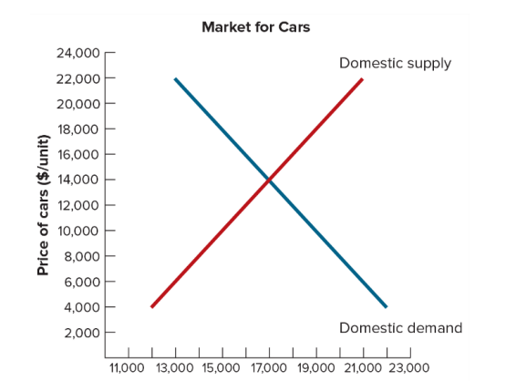
Question 5 The demand and supply for automobiles in a certain country is given in the following graph.
a) The demand and supply for automobiles in a certain country is given in the following graph. Assuming that the economy is closed, find the equilibrium price and production of automobiles.
Supply=Demand
Quantity of automobiles demanded and supplied both equal 17,000 at a price of $14,000
Therefore, this is the market equilibrium if the economy is closed.
Qo
Quantity of cars (units per year)

Slide 21
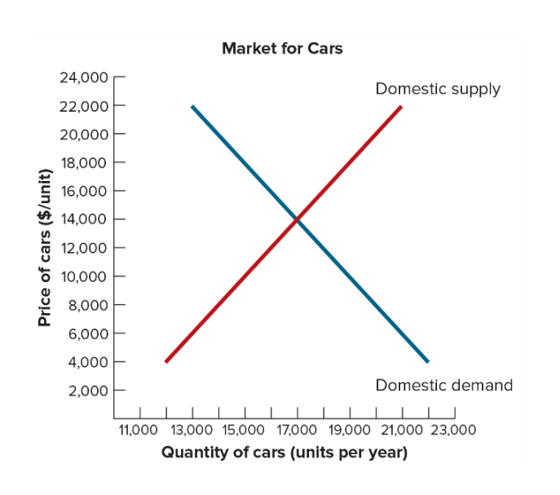
B) The economy opens to trade. The world price of automobiles is $8,000. Find the domestic quantities demanded and supplied and the quantity of imports or exports. Who will favor the opening of the automobile market to trade, and who will oppose it?
World Price = $8,000
Qs= 14,000 (Domestic Supplied)
Qd = 20,000 (Domestic demanded)
Domestic import=Qd-Qs
=20,000-14,000
=6,000 foreign-produced cars
Qo=17,000 (Quantity demanded before trade)
Qs=14,000 <17,000
Domestic producers will oppose the opening
of the automobile market to trade because they
will be forced to lower the price of their cars
to compete with cheaper foreign imports
Qd=20,000 > 17,000
Domestic consumers will favor because they will be able to buy more cars at a lower price
World Price ($8000)
Imports
Qs
Qo
Qd
Quantity of cars (units per year)

Slide 22
C) The government imposes a tariff of $2,000 per car. Find the effects on domestic quantities demanded and supplied.
World Price with tariff = $10,000
- Domestic price paid for cars increases
to $10,000
Qs' increases to 15,000 cars per year
Qd' decreases to 19,000 cars per year
World Price with tariff
World Price
Qs
Qs'
Qd'
Qd
Quantity of cars (units per year)

Slide 23
D) As a result of the tariff, what will happen to the quantity of imports or exports, and what is the revenue raised by the tariff? Who will favor the imposition of the tariff, and who will oppose it?
World Price with tariff = $10,000
- Domestic price paid for cars increases
to $10,000
Quantity of imports = Qd'-Qs'
= 19,000 – 15,000
= 4,000 cars per year
Quantity of imports decreased from 6,000 to 4,000
Revenue = Shaded area
= 2,000 (tariff) x 4,000 (New import)
= $8 million
Domestic producers will favor the imposition of the tariff since they are now able to sell more cars at a higher price
Qs' = 15,000>14,000
Domestic consumers will oppose the tariff as cars are now more expensive
World price=$10,000>$8,000
Revenue
World Price with tariff
World Price
New
Imports
Qs
Qs'
Qd'
Qd
Quantity of cars (units per year)

Slide 24
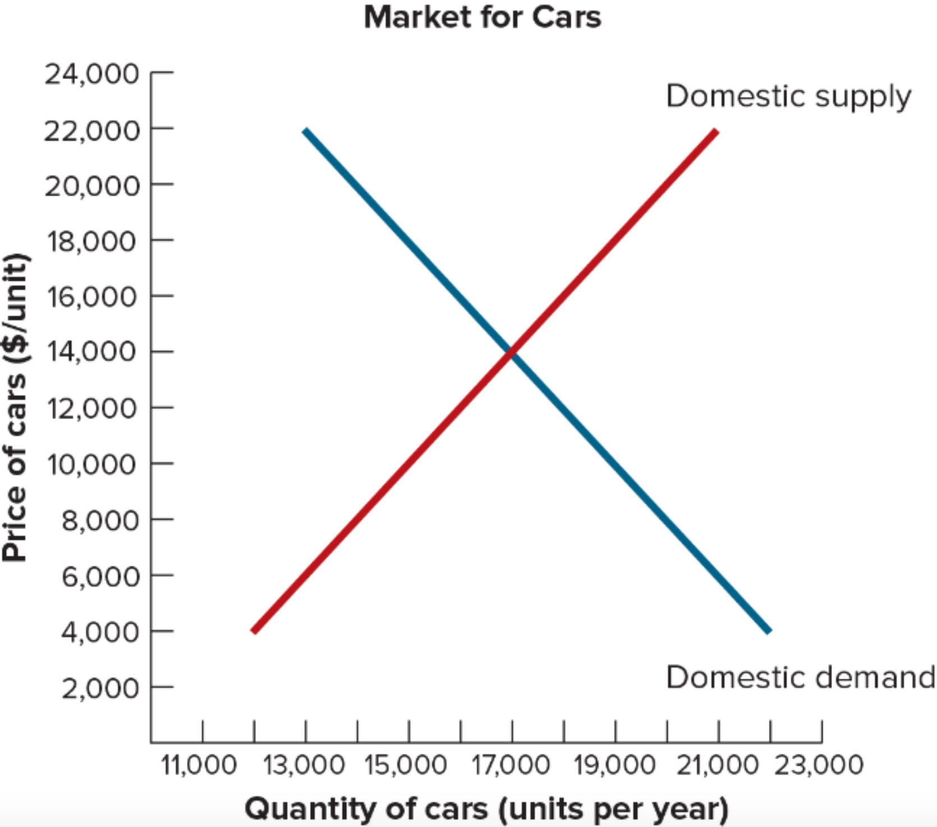
Question 6 The demand and supply for automobiles in a certain country is given in the following graph.

Slide 25
(a) The economy opens to trade. The world price of automobiles is $10,000. Find the domestic quantities demanded and supplied and the quantity of imports or exports.
Price of cars in the economy
=World price of cars
=$10,000
At P=$10,000:
Quantity demanded (Qd)=19,000
Quantity supplied (Qs)=15,000
Quantity of imports
=Qd-Qs
=19,000-15,000
=4,000
World Price
Imports
Qs
Qd

Slide 26
(b) Now assume that the government imposes a quota on automobile imports of 2,000 cars. What will happen to the quantity of imports or exports?
After the imposition of quota of 2,000 cars, supply curve of cars in the economy becomes "Domestic supply plus quota".
New market equilibrium price of cars (P')=$12,000
where (Domestic supply + quota)=Domestic demand
At P=$12,000:
Quantity demanded (Qd')=18,000
Quantity supplied (Qs')=16,000
Quantity of imports=Qd'-Qs'=18,000-16,000=2,000
Therefore, the quantity of imports falls from 4,000 to 2,000 after the imposition of quota.
Domestic supply plus quota
P'
World Price
Quota
Imports with quota
Imports without quota
Qs
Qs'
Qd'
Qd

Slide 27
(c) Who will favor the imposition of the quota, and who will oppose it?
The domestic producers of computers will favor the imposition of quota because it helps them by increasing their sales (from Qs to Qs') and the price they receive for their products (from World Price to P').
The holders of import licenses will also favor the imposition of quota because it allows them to obtain revenue by buying cars in the world market at the world price and selling them in the domestic market at a higher price P'.
In contrast, the domestic consumers of computers will oppose the imposition of quota because it results in a higher price they must pay for each unit of computers.
Domestic supply plus quota
P'
World Price
Quota
Imports with quota
Imports without quota
Qs
Qs'
Qd'
Qd

Slide 28
Question 7 The demand for automobiles in a certain country is given by D=12,000-200P where P is the price of a car. Supply by domestic automobile producers is S=7,000+50P (a) Assuming that the economy is closed, find the equilibrium price and production of automobiles
To find the closed-economy equilibrium price and quantity, we set demand equal to supply:
12,000-200P=7,000+50P
P=20
S=7,000+50*20=8,000

Slide 29
(b) The economy opens to trade. The world price of automobiles is 18. Find the domestic quantities demanded and supplied and the quantity of imports or exports. Who will favor the opening of the automobile market to trade, and who will oppose it?
If the economy opens to trade, the domestic price of automobiles will equal the world price (Pw), which is 18. At this price:
Domestic quantity demanded
=12,000-200Pw
=12,000-200*18
=8,400
Domestic quantity supplied
=7,000+50Pw
=7,000+50*18
=7,900
Therefore, quantity of imports
=8,400-7,900
=500
Domestic consumers of automobiles will favor the opening of the automobile market to trade because they will enjoy a larger quantity of automobiles at a lower price than the closed-economy price.
Domestic producers of automobiles will oppose it because they will suffer from selling at a lower price.

Slide 30
(c) The government imposes a tariff of 1 unit per car. Find the effects on domestic quantities demanded and supplied and on the quantity of imports or exports. Also find the revenue raised by the tariff. Who will favor the imposition of the tariff, and who will oppose it?
The imposition of the tariff raises the domestic price of automobiles from 18 (Pw) to 19 (Pt, price with tariff). At this price:
Domestic quantity demanded
=12,000-200Pt
=12,000-200*19
=8,200
[falls by (8,400-8,200)=200 units]
Domestic quantity supplied
=7,000+50Pt
=7,000+50*19
=7,950
[increases by (7,950-7,900)=50 units]

Slide 31
(c) The government imposes a tariff of 1 unit per car. Find the effects on domestic quantities demanded and supplied and on the quantity of imports or exports. Also find the revenue raised by the tariff. Who will favor the imposition of the tariff, and who will oppose it?
Therefore, the new quantity of imports
=8,200-7,950
=250
(falls by (500-250)=250 units)
The revenue raised by tariff
=(new quantity of imports)*(tariff per car)
=250*1
=250
Domestic producers of automobiles will favor the imposition of the tariff because they can sell more automobiles and receive a higher price for them.
The government will also favor the imposition of the tariff because it can raise revenue for the government.
Domestic consumers of automobiles will oppose it because they will have to pay a higher price for each unit of automobiles they buy.

Slide 32
(d) Can the government obtain the same results as you found in part (c) by imposing a quota on automobile imports? Explain.
Let the imposed quota be x:
Total supply of automobiles in the economy
=(Domestic supply) + quota
=(7,000+50P)+x
Since we want to obtain the same results with part (c), we set price=Pt (price with tariff)=19 and equate total supply to total demand, which is still the domestic demand:
(7,000+50Pt)+x=12,000-200Pt
(7,000+50*19)+x=12,000-200*19
x=250
Check for domestic quantities demanded (Qd) and supplied (Qs), quantity of imports (Qm):
Qd=12,000-200*19=8,200
Qs=7,000+50*19=7,950
Qm=(imports without quota-x)=500-250=250
Therefore, the government can obtain the same results as in part (c) by imposing a quota on automobile imports of 250 units except that the government cannot directly collect revenue from imposing a quota as it does from imposing a tariff.
In this case, the revenue, which equals to (Pt-Pw)*Qm=(19-18)*250=250, goes to the holders of import licenses, who can buy automobiles in the world market at Pw=18 and sell them in the domestic market at Pt=19.

Slide 33
Thank you!
---Presented by Group 10
07/11/2023

